Slide 1

Modern Education Society’s
Wadia College of Engineering Pune
“Quantum Cryptography in Indian Armed Forces”
Name of Faculty(Guide):-
Prof. Sharmila Wagh
Dept. of Computer Engineering
Prepared By:-
Apoorva Pranesh Kulkarni
TE Comp 3
F22113008

Slide 2
CONTENTS:-
Introduction
Literature Survey
Basics
Details of design / Methodology
Analytical and Experimental work
Conclusion

Slide 3
INTRODUCTION:-
When it comes to defence, we need to be secure not only on land, air or water but also digitally.
Military constantly needs sensitive information regarding satellite position, geophysical images of enemy’s terrain, location of terrorist group,secure communication line, designs of artillery, information regarding sensors, etc.
Transfer of such information should be secure and withstand cyber attack.
Quantum technology is emerging among all developed nations. USA, Russia and China are developing at faster pace in quantum technology.
USA and China military uses Quantum cryptography and they are exploring other fields as well.
Defence Cyber Agency (DCyA)A tri-service command of the Indian Armed Forces responsible for handling cybersecurity threats.
The DCyA has the capability to conduct cyber operations, including hacking, surveillance, data recovery, encryption, and countermeasures against various cyber threat actors.
The DCyA was established in August 2021. Headquartered in New Delhi, the agency is tasked with handling cyber security threats.
The military relies on secure communication to protect sensitive information and ensure mission success. From encrypted messages to sophisticated communication networks, we can incorporate quantum cryptography for safeguarding vital data.

Slide 4

LITERATURE SURVEY:-
“Quantum technology and the military revolution or hype?”
“Quantum cryptography
and quantum key
distribution protocols”
“Quantum technologies
US-China Strategic
competition
Captain Daniel Choi, USMC
6 September 2023
Ms V Padmavathi, Dr B Vishnu Vardhan, Dr A V N Krishna
2016 IEEE 6th edition
Elsa B Kania, John K Costello
2017 IEE

Slide 5
BASICS:-
We are aware about bits that is 1 or 0. Quantum bit have ability to stay in either 0 or 1 or both i.e it can exist in both states at same time. Quantum mechanics we deal with motion of sub-atomic particles.
Quantum is a discrete packet of energy. One photon of light carries exactly one quantum of energy.
Dual nature of light is the core reason. Light can behave as a particle and as a wave. That is, light behave as a particle in single slit experiment and behave as wave on double slit experiment.
Heisenberg also stated that we can either measure momentum or position of a sub-atomic particle. Measuring both at same time is impossible.
We use ‘qubit’ in quantum computing rather than ordinary bit. Superposition of two states means quantum system is in two state at a time.

Slide 6
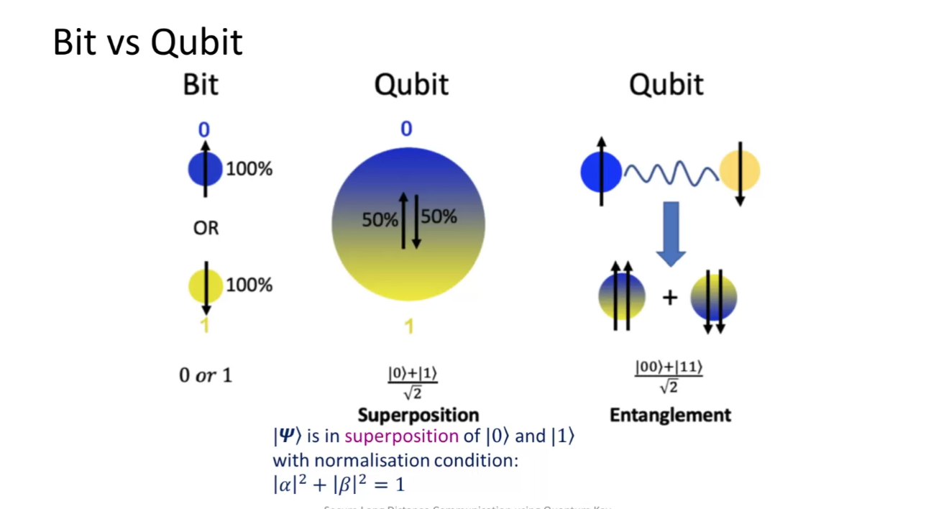
BASICS:-
There are different ways to represent qubit state.
A Dirac/Bra- Ket notation is used to describe the value of a qubit as a vector in sphere.
| Ψ > is called as ket psi or < Ψ | is called a bra psi
A qubit can in a superposition state as | Ψ> = α |0> + β |1> where,
| Ψ> = quantum state
| 0> = up spin
|1> = down spin
Probability of finding | Ψ> in either state |0> or |1>
Eg.60% probability of getting | 1>
40% probability of getting | 0>

Slide 7
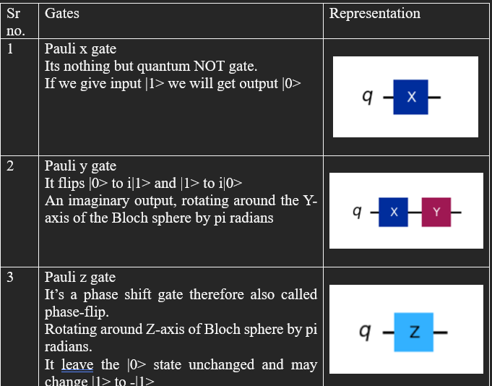
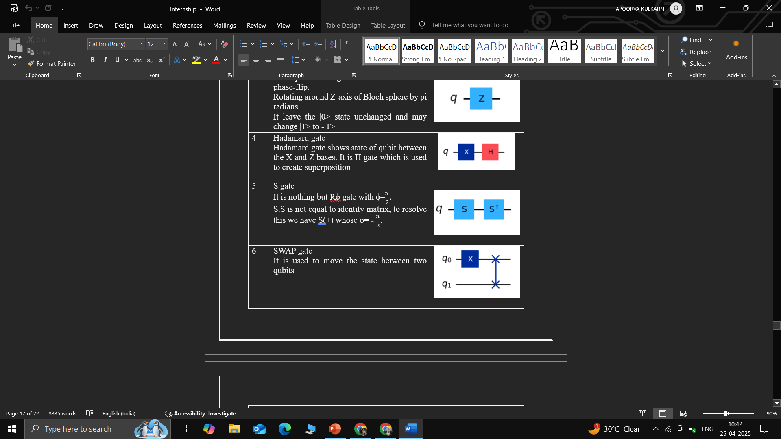
Details of design / Methodology:-
There are various gates used in quantum computing which are shown in below table.

Slide 8
Details of design / Methodology:-
Quantum frameworks
There are various frame works available like:-
1)Cirq
It is available for simulation and is provided by Google. Tensor flow Quantum is a neural network developed with artificial intelligence along with quantum computing.
2)Microsoft Quantum Development kit
Q# has interoperability with Python. It’s a high level programming language.
Azure provide hardware.
3)Qiskit – IBM
It is python based and internationally accepted therefore used widely.
It is based of principal “learn more by viewing”
IBM allows working on simulator as well actual quantum computer.

Slide 9



Quantum Cryptography: The Future of Unbreakable Communication
Unbreakable Encryption
1
Quantum mechanics ensures secure communication by leveraging the fundamental principles of quantum physics.
Key Distribution
2
Quantum key distribution (QKD) guarantees secure key exchange, making interception virtually impossible.
Future Applications
3
Quantum cryptography holds potential for revolutionizing secure communication in the military and beyond.

Slide 10

Quantum Key Distribution:-
Quantum key generator generates entangled pair of photons.
Single beam is split into two after passed through crystal and these two light beans have entangled photons.
It is sent to Bob and Alice, and they measure orientation, phase shift of photons which is sent to them through optical fibre.
Phase shift of photons, they will detect it and convert it into binary data.
Once received Alice and Bob will compare just a fraction of key via public internet channel.
If hacker steal photons, Alice and Bob can easily detect tampering. Then they will calculate error rate and decide whether to get a new key or continue with the same key.

Slide 11
ADVANTAGES AND DISADVANTAGES:-
ADVANTAGES:-
DISADVANTAGES:-
Generated randomly and securely via quantum properties
Law of quantum physics is used
It needs advance error correction
Eavesdropping can be detected
Secure against classical and quantum attacks
Due to absorption or scattering there can be photon loss
Dispersion occurs i.e signal spreads because light colours move at different speeds
Decoherence
Trust models – Reliance on trusted nodes for beam or the internet channel used for less fraction still vulnerable
Real world constraints- limited bandwidth, high cost, synchronization

Slide 12
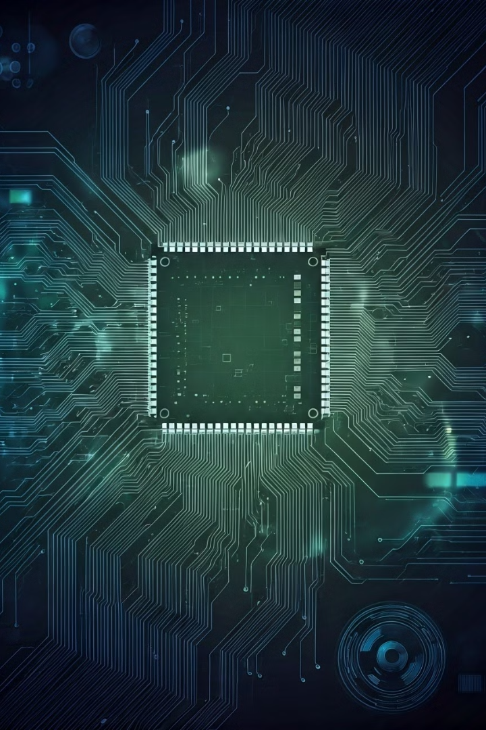
Analytical and experimental work:-
There are various types of QKD but three major types are:-
i)DV OKD – Discrete Variable QKD
ii)CV QKD – Continuous Variable QKD
iii)DPR QKD- Distributed Phase Reference QKD
There are three major protocols:-
i)BB86
ii)B91
iii)COW
.

Slide 13
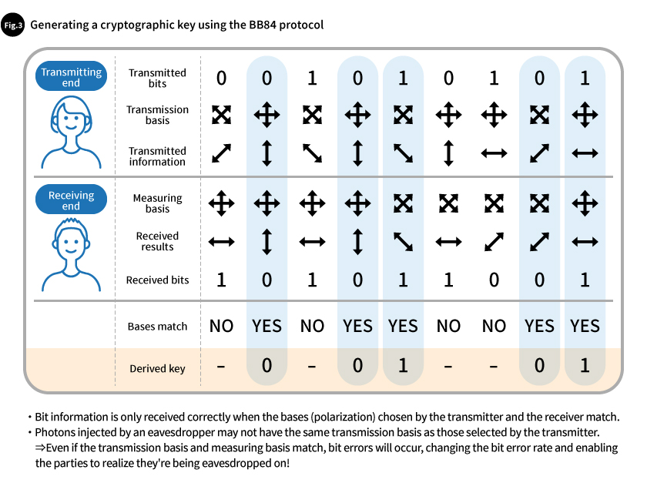
BB86:-
It is discrete variable QKD using polarization.
Based on Heisenberg uncertainity principle.

Slide 14
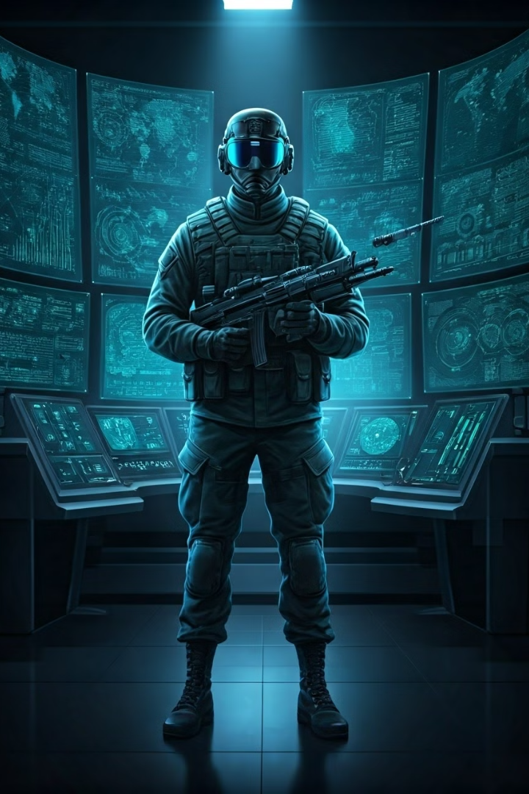
COW:-
It is based on prepare and send logic. It is distributed phase reference QKD.
COW stands for Coherent One Way QKD. Uses coherence between pulses.
The idea is:-
Alice send weak coherent light pulses.
One pulse in a time slot
Two pulses together (decoy state)
Bob measures arrival beam and checks interference in a second detector
One way signal flow reduces attack surface

Slide 15
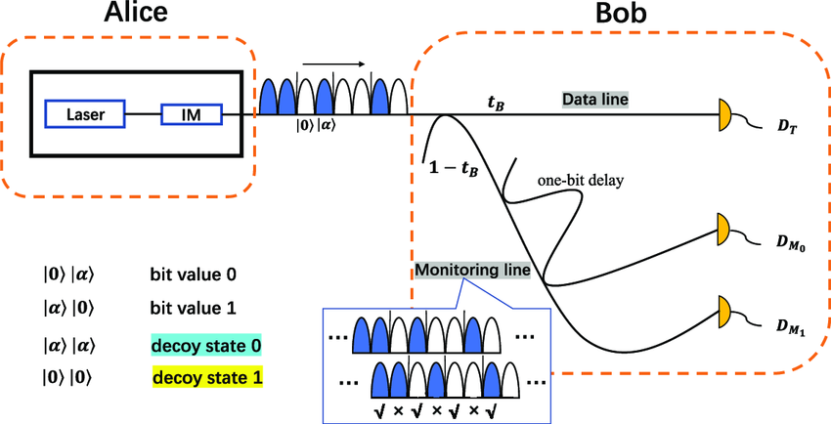
COW:-
Alice and bob then send time stamps then sifting is done and QBER(Quantum bit error rate) is measured.
If QBER>Threshold (5%) that implies that key is compromised.

Slide 16
Conclusion:-
Attacks:-
Counter measure:-
Prone to few attack like:-
i)Intercept-Resend attack
ii)Photon number splitting attack
iii)Trojan horse attack
Countermeasures can be:-
i)Monitoring QBER
ii)Authentication and error correction
iii)Decoy states

Slide 17
CONCLUSION:-
1
1st QKD from Vindhyanchal to Prayagraj i.e 100 km was set up in 2022.
2
Indian military is adopting indigenously developed QKD technology, system operating over 150 km. Trials were successful and procurement is in way
3
QNu Labs has been a key partner in providing QKD systems to the Indian Navy.
Advanced testbeds at IIT Delhi showcased entanglement-based, hybrid, and free-space QKD systems, marking a major steps toward real-world, scalable quantum communication
4

Slide 18
THANK-YOU!

